Slide 1
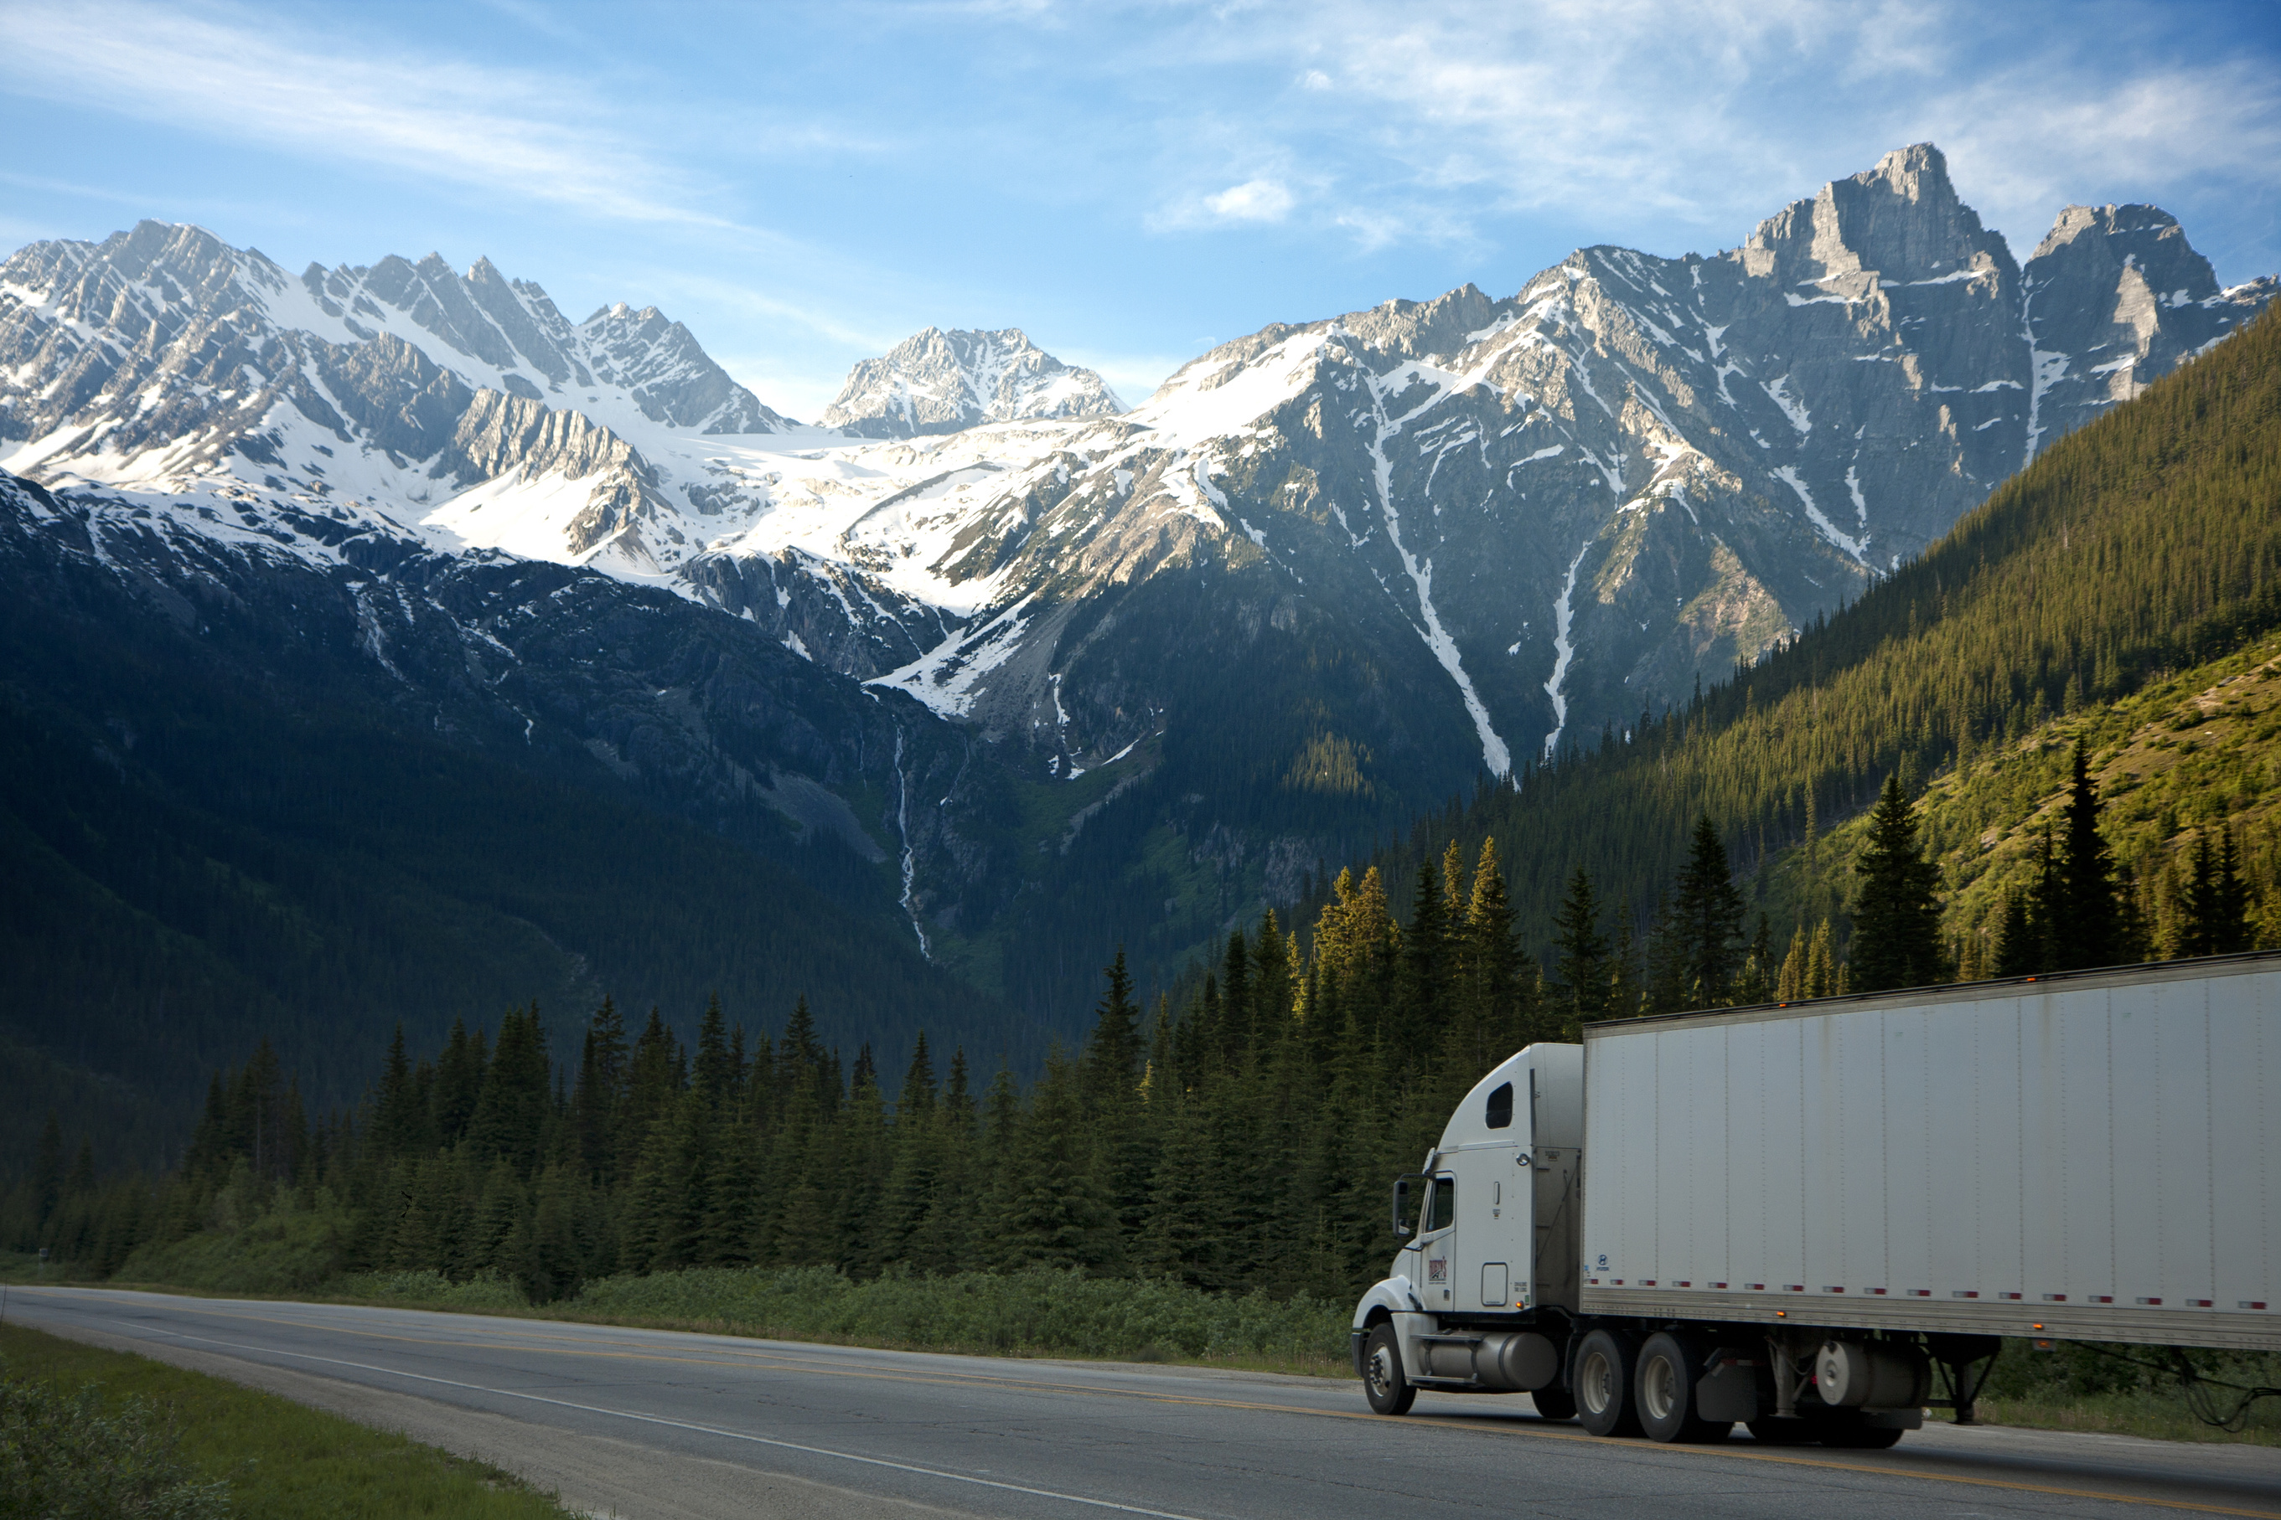
D8L
Digital Transformation in Supply Chain: Towards Cloud-Based Transport Management
Jendrik Meyer Ishan Roy Piyush Singh
Cristina Racoviță Bogdan Bîndilă
Group 9

Slide 2
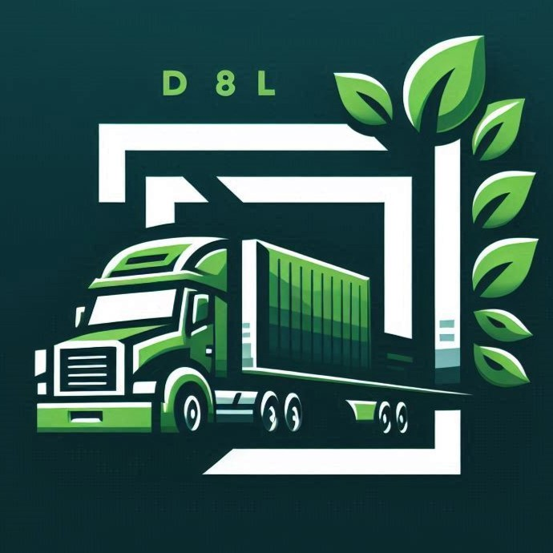
Company Introduction
D8L
Fictional logistic service provider based in Rotterdam with more than 20 years of experience
Their processes are
not automated
The new CEO wants D8L to become a 4PL
Struggles with stagnant profits and no market share increase
87% of contracts are fixed and long-term, while the rest are short-term or one-off orders
Provides road, rail and waterway
transport in the Netherlands,
Germany, Italy, Austria, and Poland
Notes:
PIYUSH
D8L is a multinational logistics service provider based in Rotterdam with over 20 years of experience operating in the logistics industry.​
Their new CEO has a vision to transform D8L into a 4PL fourth-party logistics provider. This transition is crucial for them to stay competitive in the current scene​
Currently 87% of their contracts are fixed and long-term which provides stability. While 13% are one-off orders, which present opportunities for growth​
We then performed a SWOT analysis of d8l to determine how we could leverage their capabilities and address the challenges​

Slide 3
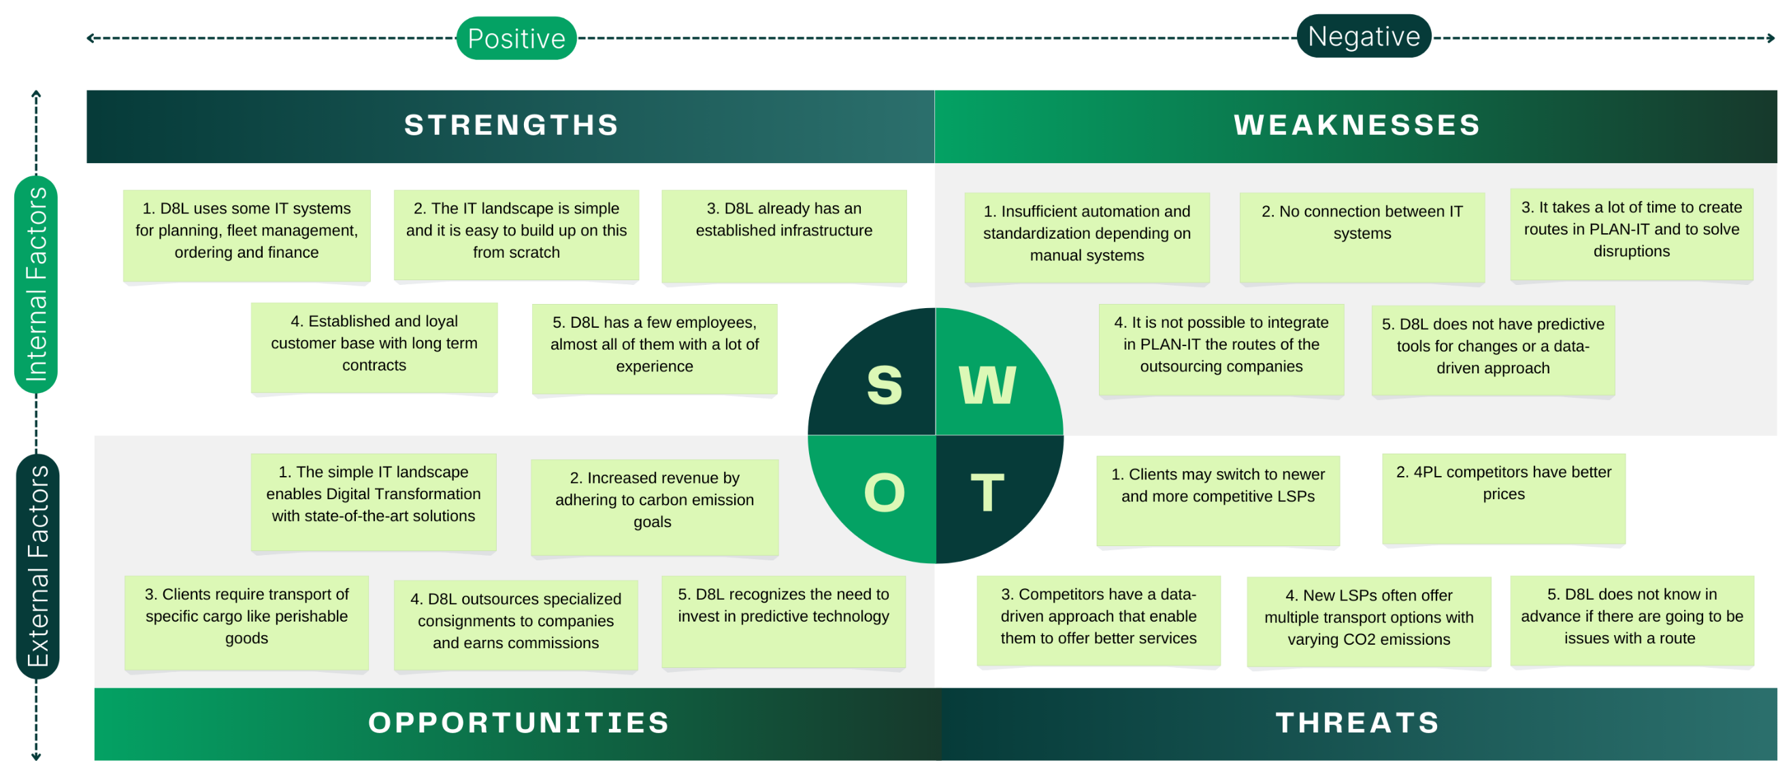
SWOT Analysis
Top 5 most relevant points
Notes:
PIYUSH
Strengths:​
1. D8L already uses some IT systems for their core operations and fleet management which gives provides a foundational technological base to build upon. And they have an established physical and IT infrastructure for easier scalability​
2: their long term contracts serve as a loyal customer base, providing a stable revenue stream to supports future initiatives​
Some key shortcomings we’ve found in their operations are:​
Weaknesses:​
1: their IT systems aren’t integrated and they face significant challenges from the acute lack of automation and an overreliance on manual procedures causing inefficiencies​
2. moreover creating routes in their main PLAN-IT system and addressing disruptions takes considerable time as it requires initiating manual phone calls across departments, affecting responsiveness​
3. They have a lack predictive tools crucial for data-driven decision-making required for a 4PL company​
This then contributes to the main threats they face today, which are:​
Threats:​
1: Many 4PL competitors often offer better pricing models, and can poach their clients away from them​
2: Competitors with a data-driven approaches offering a variety of transport options with transparent co2 footprints can offer superior services​
3: Their current systems do not provide any advance warnings of potential route issues, negatively impacting their reliability​
However that aside, these challenges create a door to a number of opportunities to be capitalised on​
Opportunities:​
1: On the bright side, d8l’s simple IT landscape presents an excellent opportunity for digital transformation employing state-of-the-art solutions​
2: Adhering to environment sustainability goals opens avenues for increased revenue through green initiatives​
3: Some clients require specialized transport for specific cargo like perishable goods, which that d8l can supply​
With this in mind, we can now discuss our plans to address this​
​

Slide 4
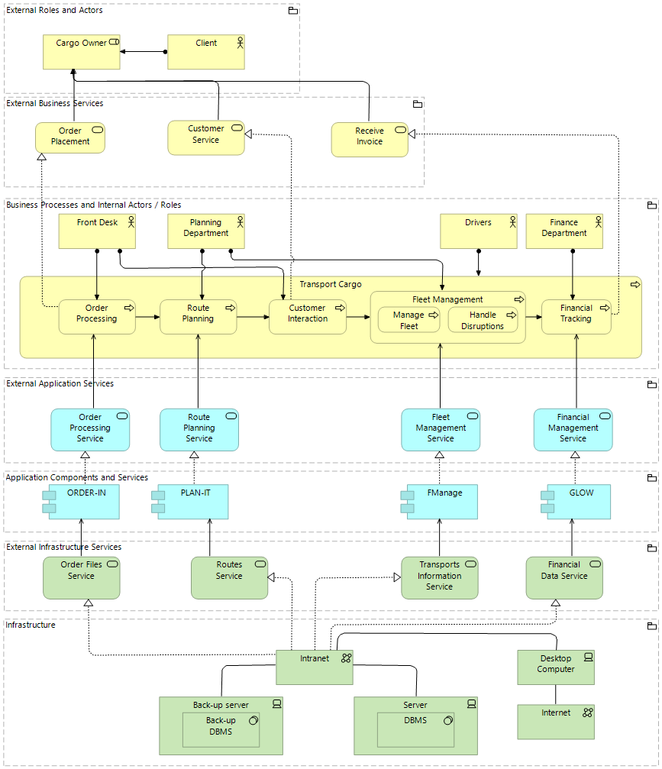
Layered Viewpoint As-Is
Notes:
BOGDAN
Enumerate the business processes
Customer interaction doesn't have a dedicated information system
There are 4 applications that don't communicate with each other (silo applications)
Infrastructure is represented by a server with a DBMS, both being backed up

Slide 5
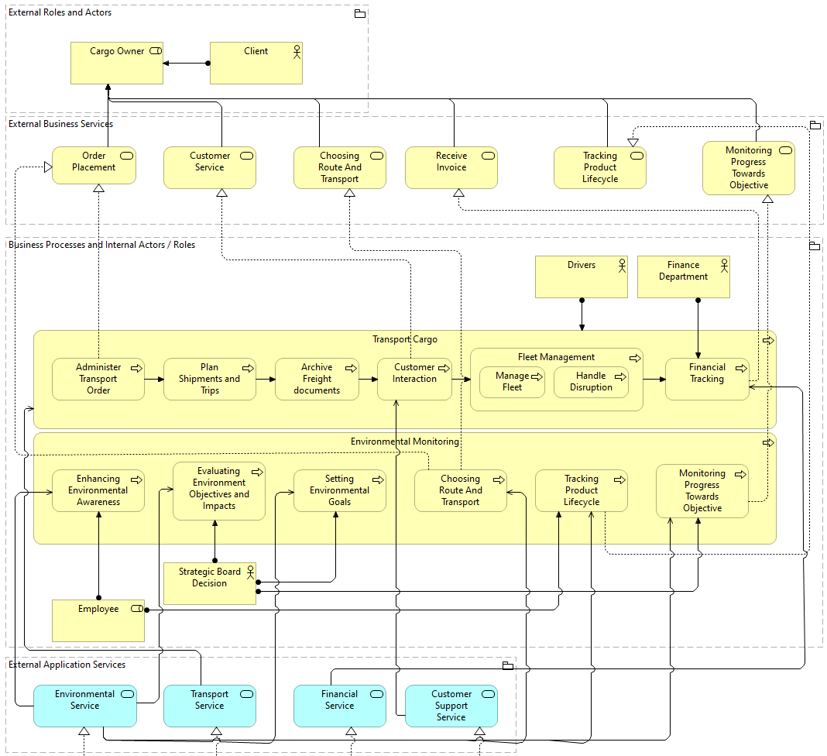
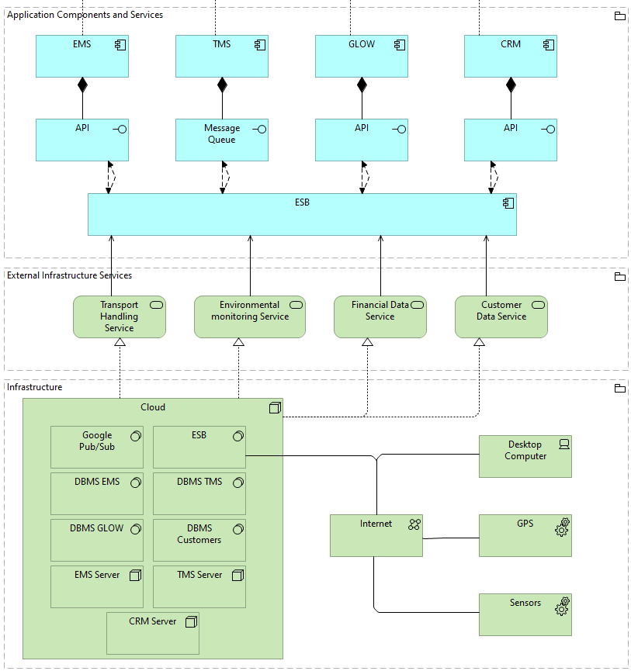
Layered Viewpoint To-Be
Notes:
BOGDAN
Enhanced set of business services divided into 2 main categories – cargo transport and environmental monitoring
Route planning and disruption handling is done automatically, leading to a data-driven business
There will be a specific application for handling customer interaction, users have the option to customize the transports
Four main applications will serve these processes (EMS, TMS, GLOW and CRM) - integrated with a ESB that handles heterogeneous integrations with various customers, leading to a 4PL company
In terms of infrastructure, the information systems will be hosted in cloud and communicate with GPS and sensors data from trucks

Slide 6
1
Infrastructure Improvement Plateau
Notes:
BOGDAN
Now we are going to show you how this migration can be done step by step.

Slide 7
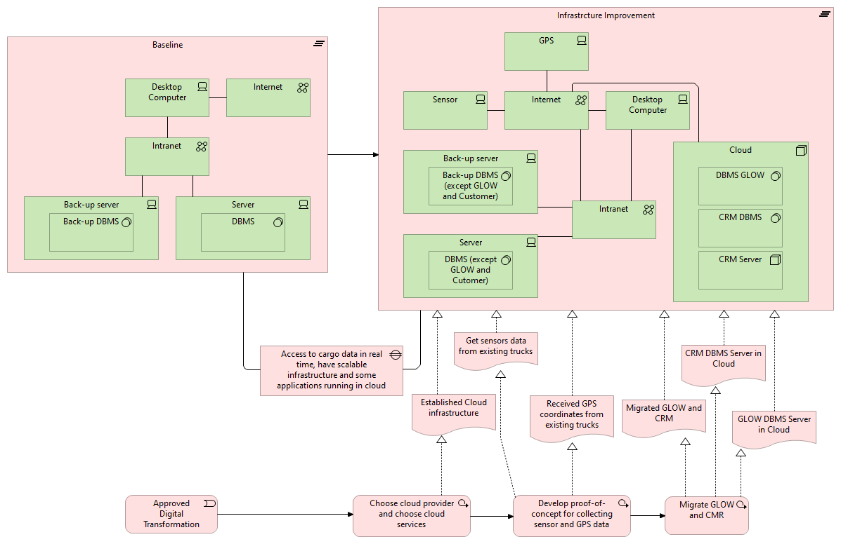
Notes:
BOGDAN
Moving from the baseline to the first intermediate plateau, we advise a first infrastructure improvement by choosing a cloud provider and migrating GLOW and the backend of CMR which is used only internally into the cloud.
On top of this, we consider that the connection of sensors and data acquisition is essential for the next steps of the digital transformation.

Slide 8
2
Adding TMS
Notes:
PIYUSH
After carefully examining the D8L organization, we performed a SWOT analysis
The figure presents the main points from the perspective of conducting the digital transformation
Strengths -> The most important strengths are that D8L uses software solutions based on well-known processes, a simple IT landscape, and an established infrastructure.
Weaknesses -> The biggest issues revolve around the lack of automation because almost all procedures are manual or semi-automated, leading to slow processes and lower-quality services compared to their competitors.
Opportunities -> The most significant opportunity is represented by the almost rudimentary IT landscape which enables us to easily design software without the need to adapt many complex IT systems and regulations around carbon emission that would enable the company to increase margins and become competitive.
Threats -> D8L is susceptible to losing its clients considering that the competitors offer better and cheaper services.
SWOT:
in general we observed an acute deficiency of automation and use of digital tools in places where it would greatly expedite there general flow of operations

Slide 9
Transport Management System
We used microservices to design the TMS app.
Each big functionality represents one microservice.
Transport Order Application
Shipment Planning Application
DMS Application
Manages the creation and tracking of transport orders
Optimizes shipment routes and schedules using advanced analytics for efficient, real-time logistics management
Centralizes logistics document management, ensuring easy access, retrieval, and regulatory compliance
Progress Application
Finance Application
IDS Application
Tracks the progress of logistical operations against set objectives, focusing on cost-effectiveness and operational timelines
Supports financial operations and customer invoicing
Secures data exchanges in the logistics network, ensuring compliance and enhancing inter-company communication reliability
Notes:
JENDRIK
Manages the creation and tracking of transport orders
Utilizes advanced analytics to configure optimal shipment routes and schedules, enhancing efficiency and enabling real-time response to logistical challenges Centralizes the management of all logistics-related documents, including freight documentation, to ensure easy access, retrieval, and compliance with regulations
Tracks the progress of logistical operations against set objectives, focusing on cost-effectiveness and operational timelines
Supports financial operations and customer invoicing
Manages secure data exchanges within the logistics network, ensuring compliance with data protection standards and enhancing the reliability of inter-company communications

Slide 10
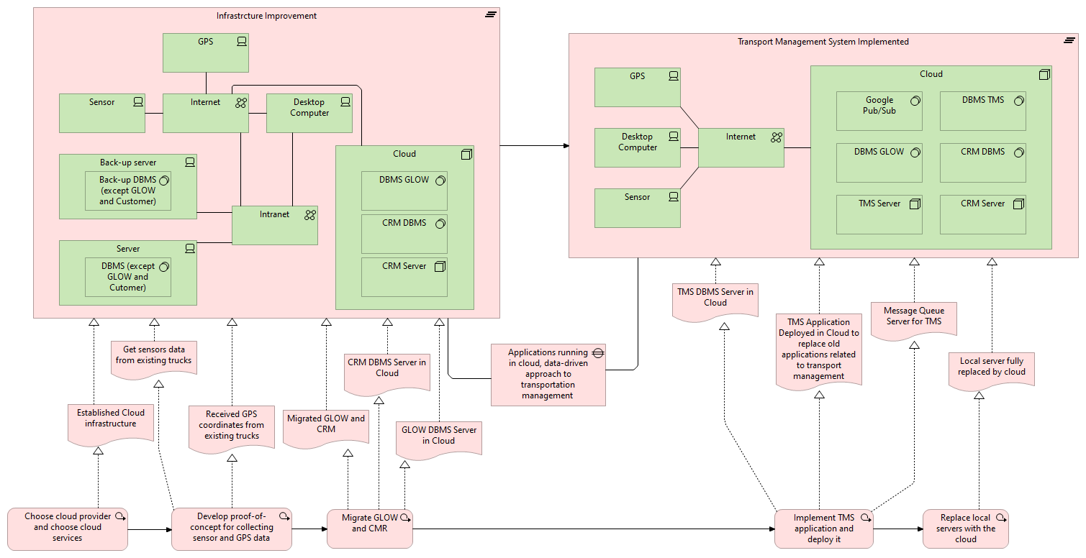
Notes:
PIYUSH
After carefully examining the D8L organization, we performed a SWOT analysis
The figure presents the main points from the perspective of conducting the digital transformation
Strengths -> The most important strengths are that D8L uses software solutions based on well-known processes, a simple IT landscape, and an established infrastructure.
Weaknesses -> The biggest issues revolve around the lack of automation because almost all procedures are manual or semi-automated, leading to slow processes and lower-quality services compared to their competitors.
Opportunities -> The most significant opportunity is represented by the almost rudimentary IT landscape which enables us to easily design software without the need to adapt many complex IT systems and regulations around carbon emission that would enable the company to increase margins and become competitive.
Threats -> D8L is susceptible to losing its clients considering that the competitors offer better and cheaper services.
SWOT:
in general we observed an acute deficiency of automation and use of digital tools in places where it would greatly expedite there general flow of operations

Slide 11
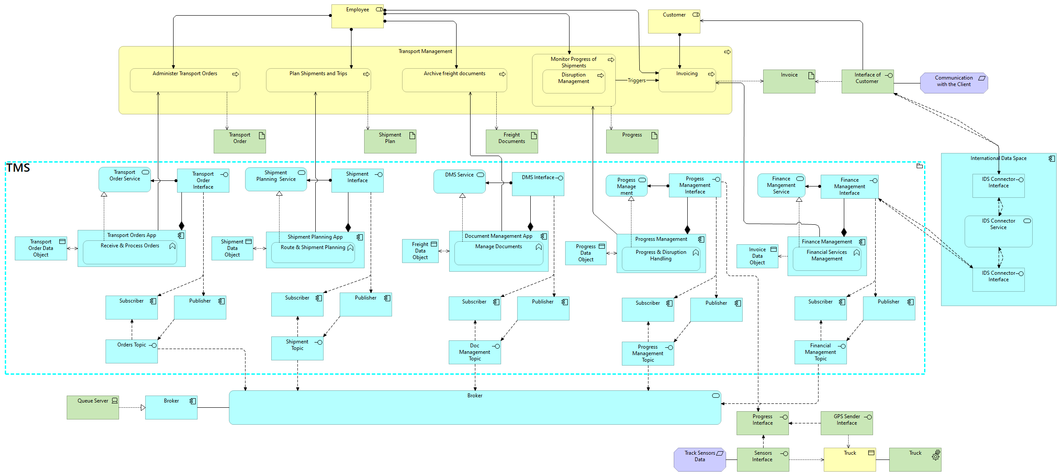
TMS
Notes:
JENDRIK

Slide 12
3
Adding EMS
Notes:
Cristina The next step is implementing the EMS application, which handles the environmental goals for D8L.

Slide 13
Environmental Management System
We used microservices to design the EMS app.
Each big functionality represents one microservice.
Training Application
Evaluation Application
Goal Application
Raises employees' awareness about environmentally friendly transport.
Gains the transport configurations and make some reports based on them
Helps the strategic board to set a goal for a certain period.
Monitor Application
Configuration Application
Tracking Application
Monitor energy conservation, employees' awareness, and operational costs, comparing everything with the set goal
Customers can choose the route and the transport mode they want, making the adoption of less polluting transports easier
Tracks CO2 emissions using sensors from D8L's fleet or outsourcing monitoring interface
Notes:
Cristina
We split the functionalities into microservices, each responsible for a specific role, meeting in this way our client's requirements.
We have six applications: for employees training, evaluation, goal setting, energy conservation monitoring, route configuration and carbon emissions tracking.

Slide 14
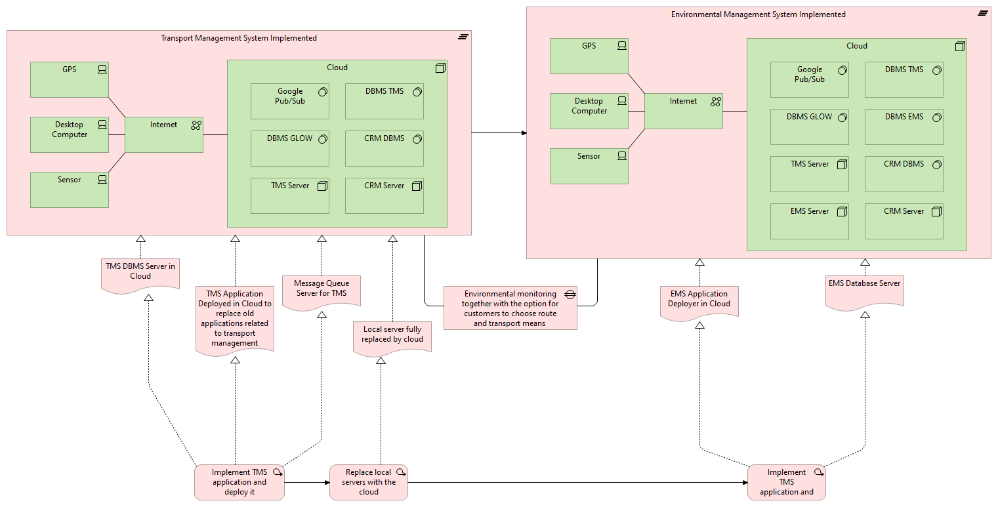
Notes:
Cristina
For these, we need to add a new node and a database server in the cloud. This is a high level representation of EMS.

Slide 15
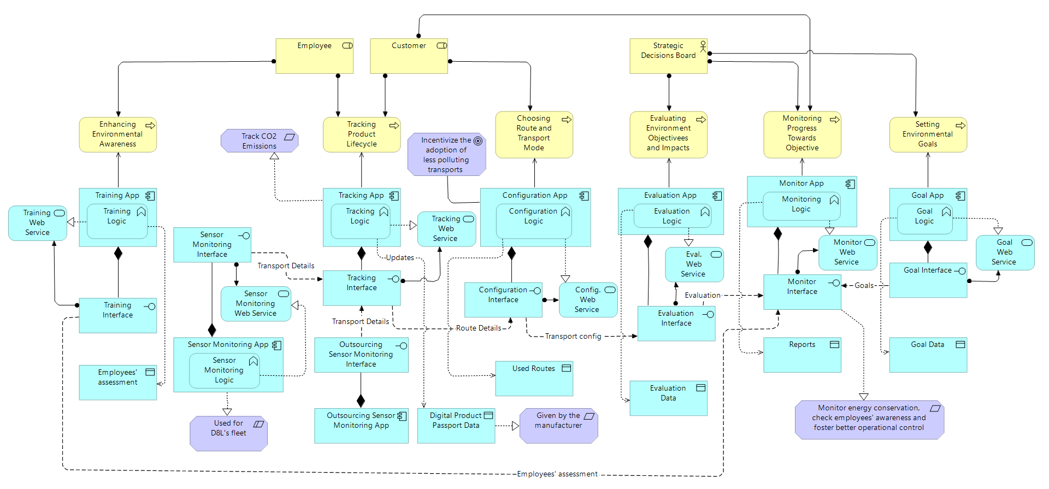
EMS
Notes:
Cristina
Looking in depth, we can see all the previous mentioned microservices, which communicate using a REST API protocol, and each of them having a specific business function.

Slide 16
4
Integration Implementation
Notes:
PIYUSH
After carefully examining the D8L organization, we performed a SWOT analysis
The figure presents the main points from the perspective of conducting the digital transformation
Strengths -> The most important strengths are that D8L uses software solutions based on well-known processes, a simple IT landscape, and an established infrastructure.
Weaknesses -> The biggest issues revolve around the lack of automation because almost all procedures are manual or semi-automated, leading to slow processes and lower-quality services compared to their competitors.
Opportunities -> The most significant opportunity is represented by the almost rudimentary IT landscape which enables us to easily design software without the need to adapt many complex IT systems and regulations around carbon emission that would enable the company to increase margins and become competitive.
Threats -> D8L is susceptible to losing its clients considering that the competitors offer better and cheaper services.
SWOT:
in general we observed an acute deficiency of automation and use of digital tools in places where it would greatly expedite there general flow of operations

Slide 17
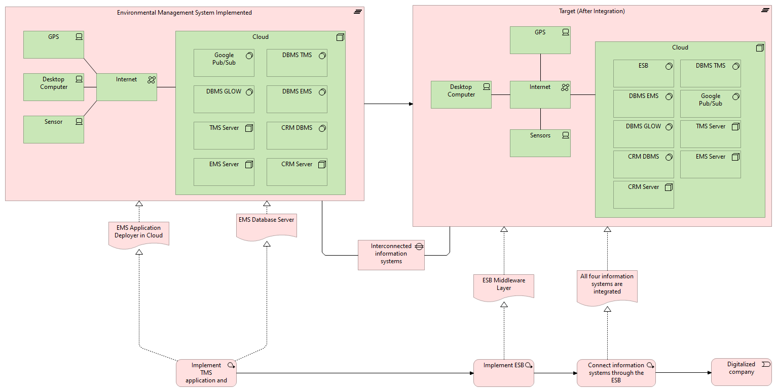
Notes:
PIYUSH
After carefully examining the D8L organization, we performed a SWOT analysis
The figure presents the main points from the perspective of conducting the digital transformation
Strengths -> The most important strengths are that D8L uses software solutions based on well-known processes, a simple IT landscape, and an established infrastructure.
Weaknesses -> The biggest issues revolve around the lack of automation because almost all procedures are manual or semi-automated, leading to slow processes and lower-quality services compared to their competitors.
Opportunities -> The most significant opportunity is represented by the almost rudimentary IT landscape which enables us to easily design software without the need to adapt many complex IT systems and regulations around carbon emission that would enable the company to increase margins and become competitive.
Threats -> D8L is susceptible to losing its clients considering that the competitors offer better and cheaper services.
SWOT:
in general we observed an acute deficiency of automation and use of digital tools in places where it would greatly expedite there general flow of operations

Slide 18
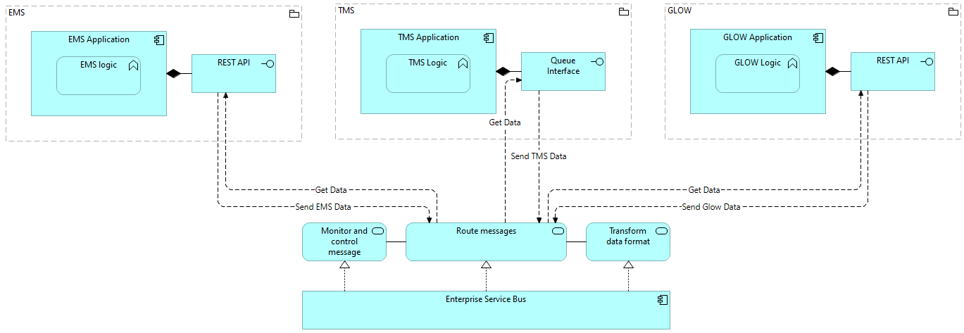
Application Cooperation Viewpoint

Slide 19
The Impact and Side-Effects
Positive Impacts
Potential Side-Effects and
Ripple Effects
Real-time Data Access and Enhanced Infrastructure:
Faster & Improved Decision-Making
Cloud infrastructure ensures data is not lost and systems are robust
Cloud services provide the scalability
Advanced-Data Integration and Analysis:
Data-Driven Approach
Enhanced Customer Relationship Management
Environmental Monitoring and Management:
Sustainability goals & Compliance with regulations
Infrastructure and Security Challenges:​
Data Security & Data Migration Risks​
Operational Disruptions:​
Downtime During Transition & Training and Adaptation​
Integration and Interoperability Issues:​
System Compatibility & Middleware Layer Complexity

Slide 20
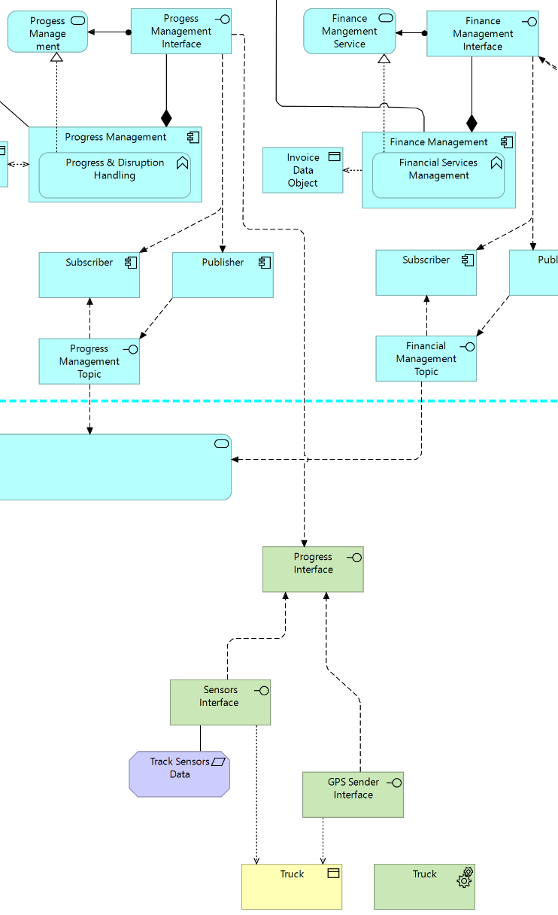
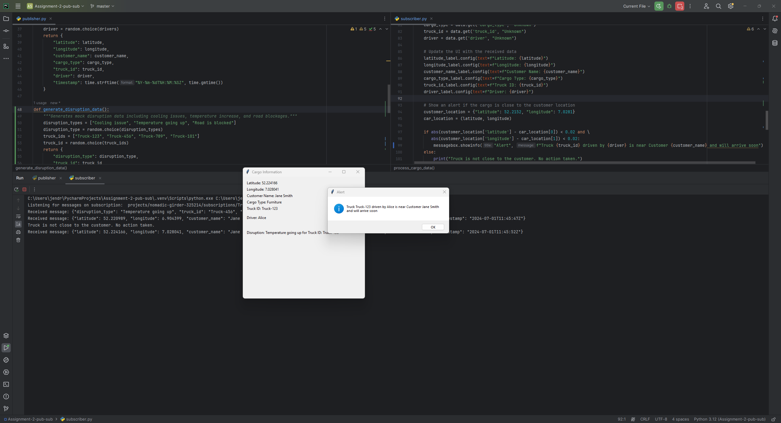
Prototype
Message Broker for Disruption and Location Management

Slide 21
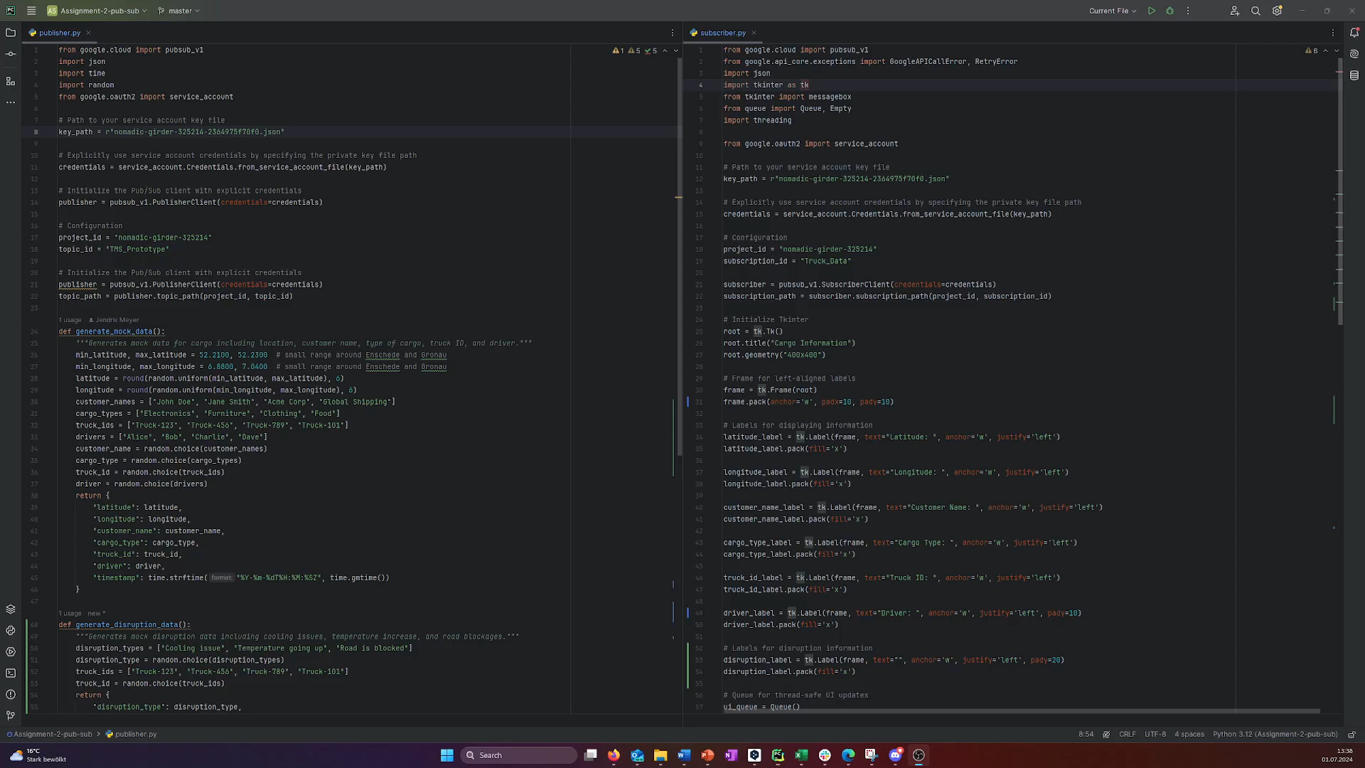

Slide 22
D8L
Thank you for your attention!
Questions?
Jendrik Meyer Ishan Roy Piyush Singh
Cristina Racoviță Bogdan Bîndilă
Group 9

Slide 23




Choosing an In-House Built Solution
Reason for In-House
First Steps Towards Becoming a 4PL
Integration
Cost Efficiency
Customization
and Scalability
Notes:
JENDRIK

Slide 24





Choosing an In-House Built Solution
Third-Party Solutions
TMS
SAP EHS and Transport Management System
High Implementation Costs
Customization Restrictions / Limitations
Dependency on Vendor
Complex Integration
EMS
Notes:
JENDRIK

Slide 25
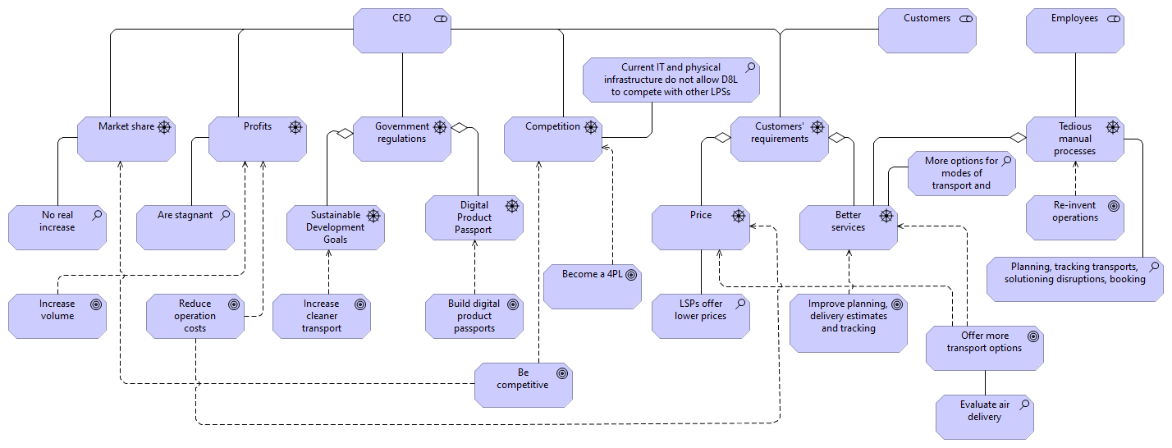
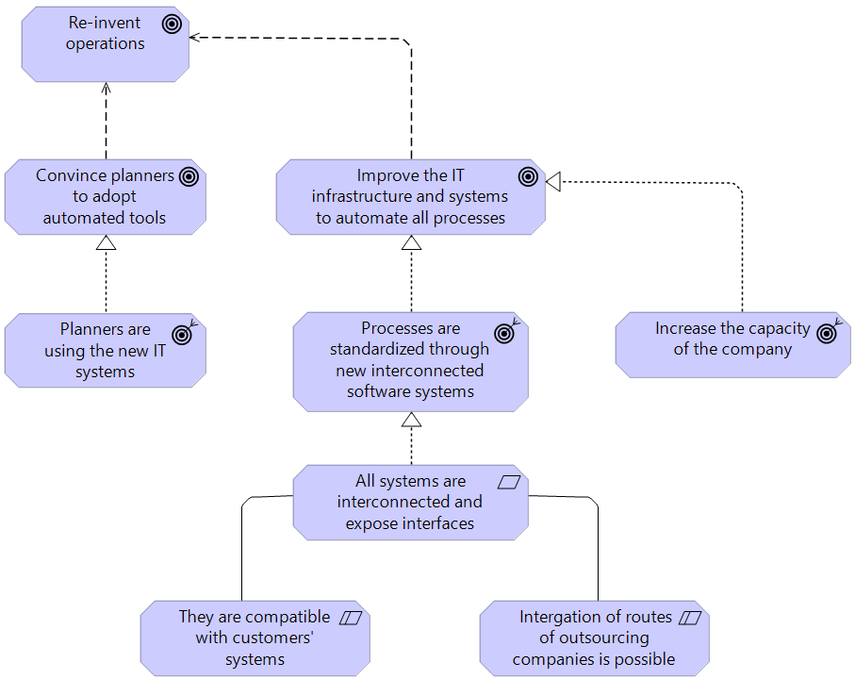
Motivation Viewpoint
Stakeholder Viewpoint
Section of the
Goal Realization Viewpoint
The goals of the organization can be achieved by implementing two systems:
Transport Management System (TMS)
Environmental Management System (EMS)
Notes:
JENDRIK
LSP = Logistic Service Provider The motivation of D8L is represented with the stakeholder and goal realization viewpoints.
The stakeholders are the CEO, customers and employees. Each has different drivers, for example the CEO is driven by the government regulations and the competition, the customers by their requirements and the employees by the tedious manual processes.
On the right hand side we can observe a section of the second viewpoint that detail the goal of re-inventing the operations.
TMS and EMS fulfill the goals of the organization.

Slide 26
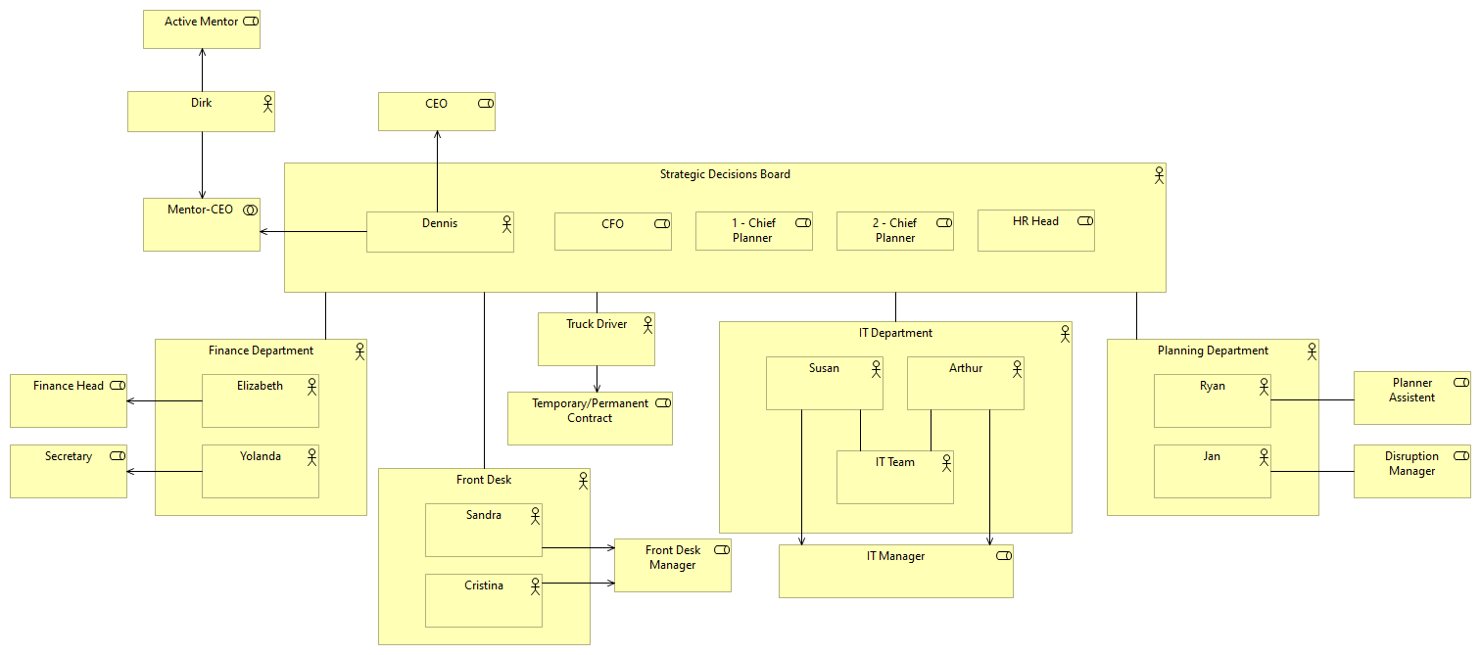
Organizational Viewpoint As-Is
6 Main Departments
Strategic Decisions Board
IT
Finance
Front-Desk
Planning
Drivers
Notes:
JENDRIK

Slide 27
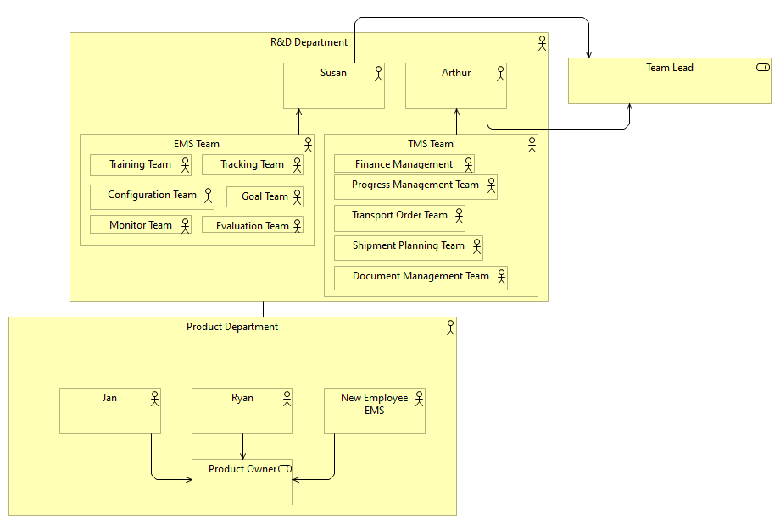
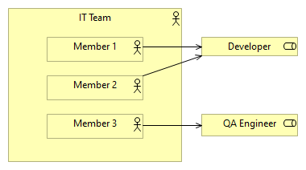
Organizational Viewpoint To-Be
Changes
R&D and Product Departments
Each Microservice = One Team
Jan and Ryan = Product Owners
IT Team
2 Devs
1 QA
Susan and Arthur = Team Leads
Notes:
JENDRIK
IT-Department to R&D Department (Susan and Arthur two managers)
For each Microservices 2 developers and 1 QA
Product new department with previous explanning department
One new employee for EMS and know the environmental EU laws
The main change is extending the IT Department and renaming it into R&D Department. The previous two managers, Susan and Arthur are now team leads. For each microservice application we identified, we have one responsible team formed by two developers and one QA. Product is one new department, where the people from the ex-planning department are involved now, being product owners. We need one new employee for the EMS app, a new product owner who knows the new environmental EU laws.

